Slide 1

Intro to Angular 2

Slide 2
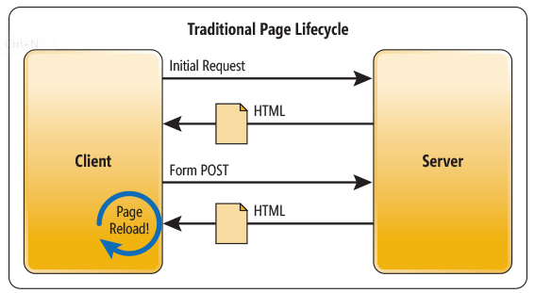
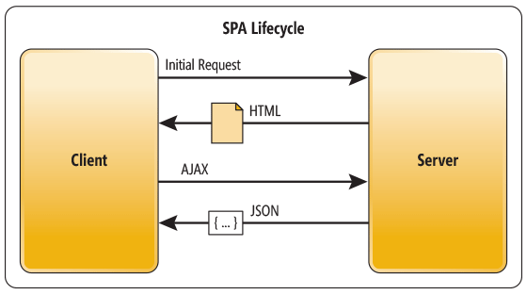
SPA

Slide 3
AngularJs
First off, why use JavaScript?
To dynamically update your HTML document and to get data to and from it.
AngularJS is a framework (a JavaScript library) that makes it easier to communicate between your HTML document and JavaScript.

Slide 4
What is MVC?
  Model – the data, not necessarily the data from the database.
  View – the user interface, what the user sees and interact with.
  Controller – the interface between the model and the view

Slide 5
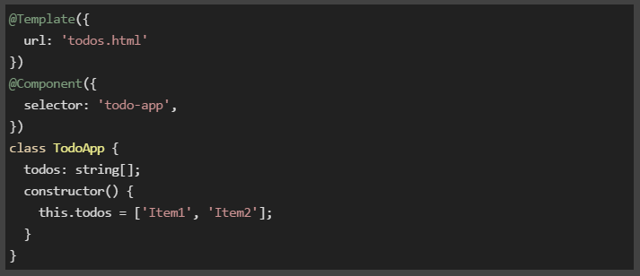
Angular 2

Slide 6
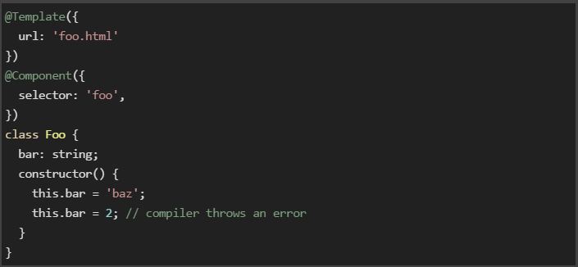
TYPESCRIPT
A typed superset of JavaScript that compiles to plain JavaScript

Slide 7
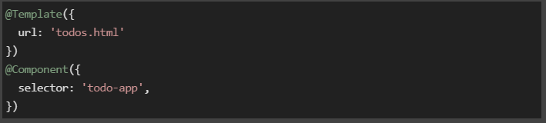
Component Annotations

Slide 8
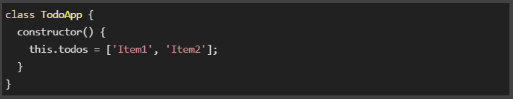
Component Controller

Slide 9
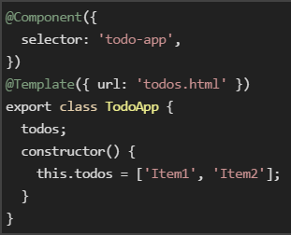

Bootstrapping
Create Components
bootstrap

Slide 10
ANGULAR 2
Create Components
Create Template
Bootstrap
Transpilation

Slide 11
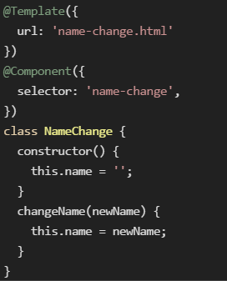
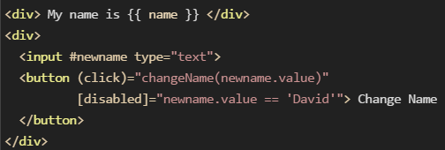
Template Syntax
Component
Template

Slide 12
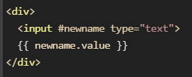
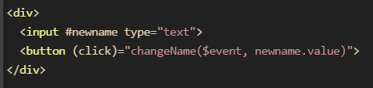
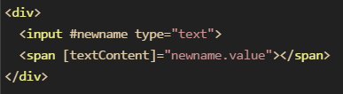
Other Concepts
Local Variables
Event Handlers
Property Bindings

Slide 13
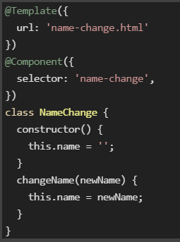
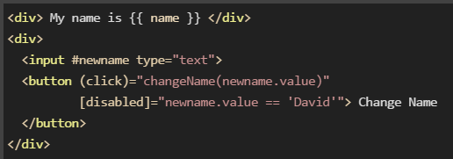
name-change.ts
name-change.html

Slide 14
Study Materials
http://blog.thoughtram.io/exploring-angular-2/
https://egghead.io/lessons/angular-2-say-hello-world-to-angular-2
GitHub
https://github.com/timjacobi/angular2-education/

Slide 15
Annotations
Annotations
  @Component: Tells that class is a component
  @View: Tells info about view of the component.
  @Directive: attach behavior to elements in the DOM.
  @Pipe: Intercept a value before it’s rendered in the template.
  @Injectable: dependency Injection.

Slide 16
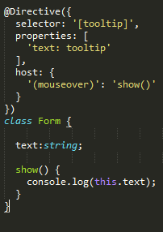
@Directive
This directive will log a tooltip into the console on every time mouse enters a region:

Slide 17
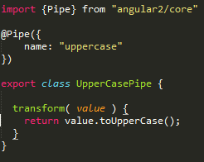

@Pipe

Slide 18
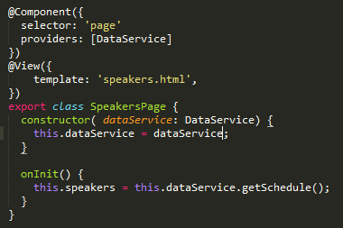
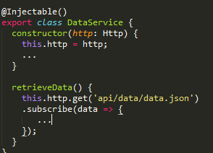
@Injectable

Slide 19
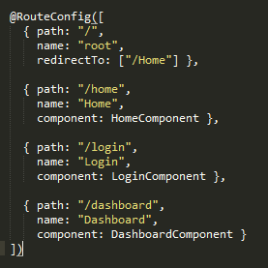
@RouteConfig
Notice here that we:
use path to specify the URL
our routes must have a name attribute
we specify the component we want to route to
we can redirect using the redirectTo option, giving a route name

Slide 20
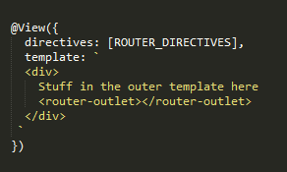
RouterOutlet
RouterOutlet directive tells our router where to render the content in the view

Slide 21
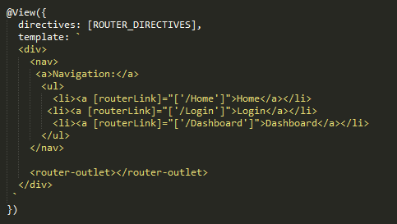
RouterLink
RouterLink directive navigate between routes

Slide 22
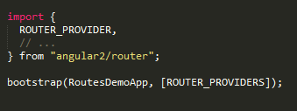
ROUTER_PROVIDERS
There's one last thing we need to do to configure use routes in our application is to inject ROUTER_PROVIDER into our app.

